Slide 1
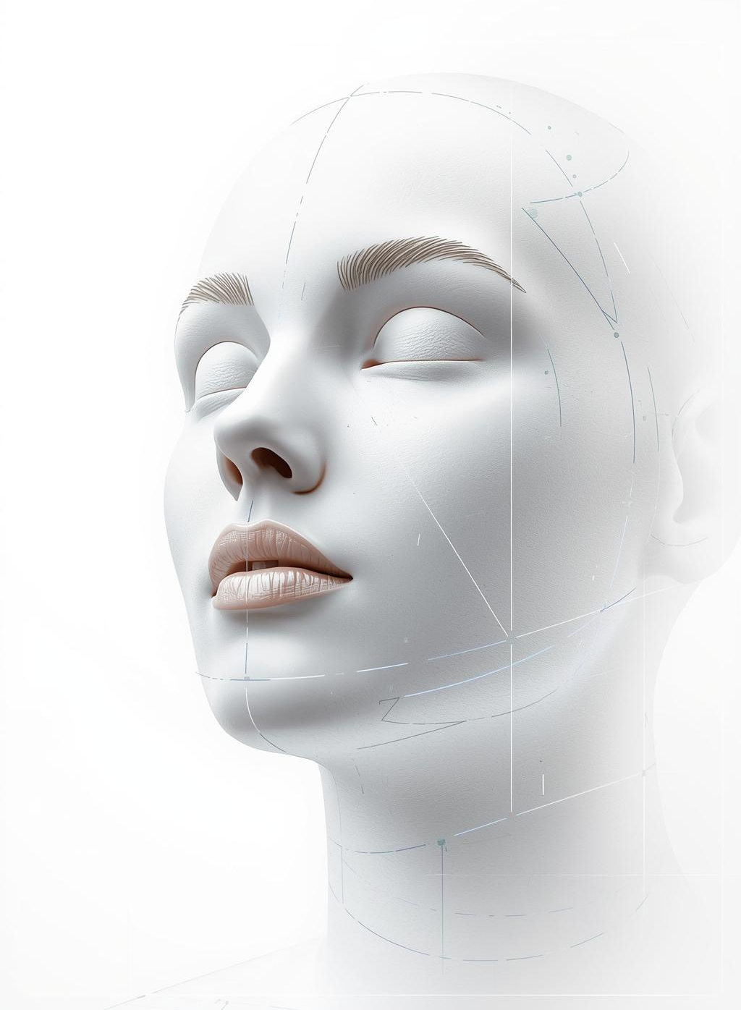
AI-Powered Skin Condition Detection
December 2, 2025

Slide 2

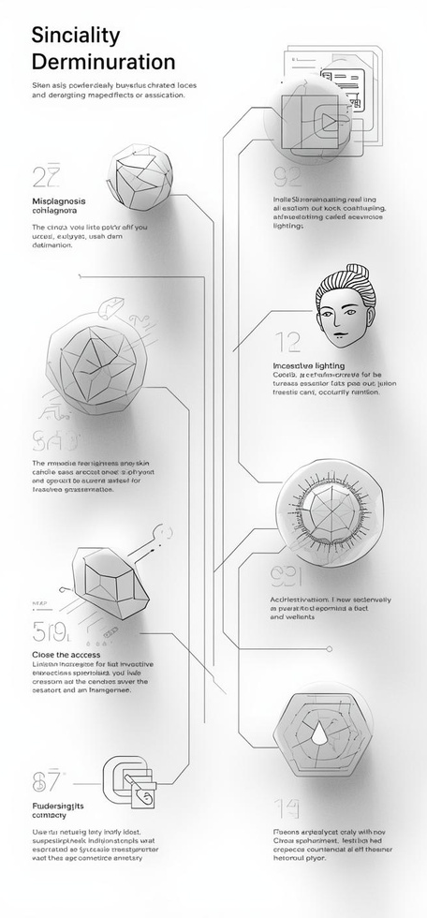
AUTOMATION
Need for Skin Analysis
Many individuals experience misdiagnosis due to varying conditions, limited access to professionals, and inconsistent lighting. Automating analysis enhances accuracy and accessibility for users.

Slide 3
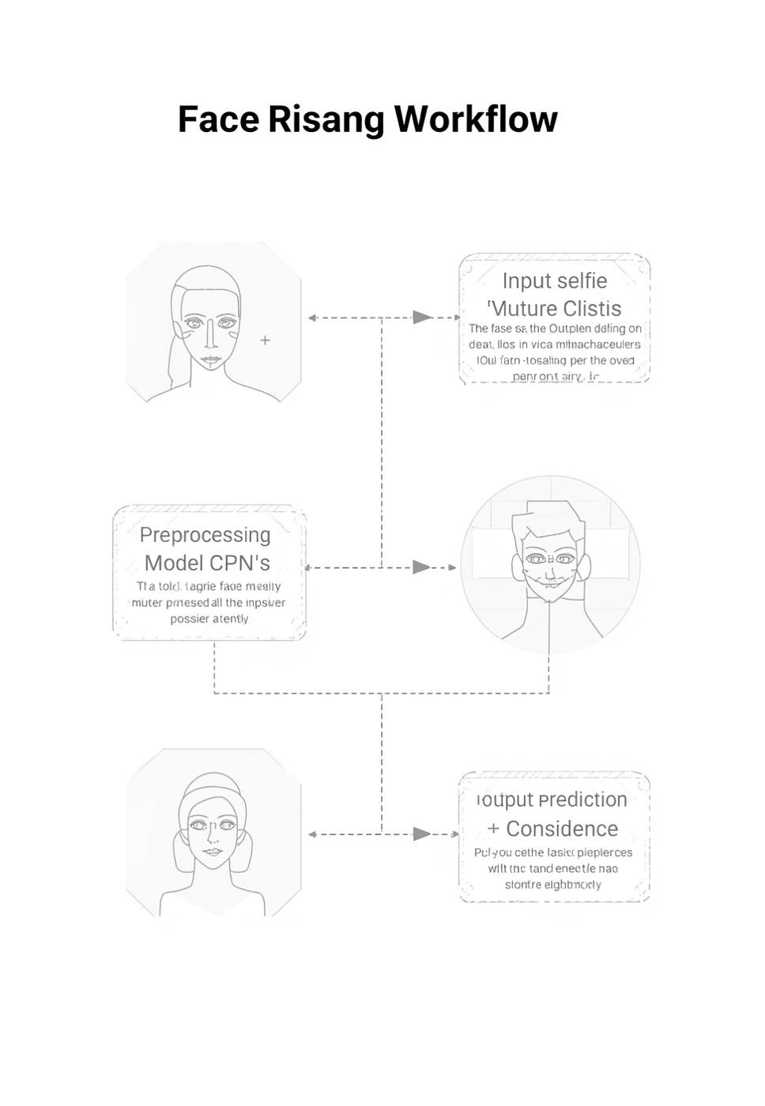
AI-POWERED SKIN DETECTION
PROPOSED SOLUTION
AI-Based Face Analysis
Understanding the Workflow
The AI-powered face analysis solution leverages machine learning to analyze selfies for skin condition detection. The workflow begins with image preprocessing, followed by a convolutional neural network (CNN) that identifies patterns. The final output includes predictions with confidence metrics, ensuring reliable results for users.

Slide 4
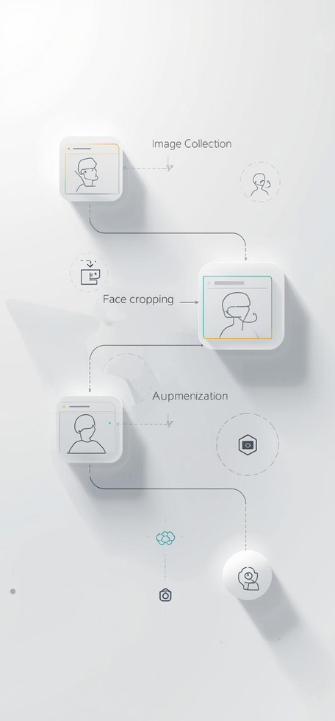
DATA PIPELINE
Pipeline & Preprocessing Overview
Our pipeline processes ~4000 images, utilizing techniques like face cropping, normalization, and data augmentation to enhance model robustness and accuracy.

Slide 5
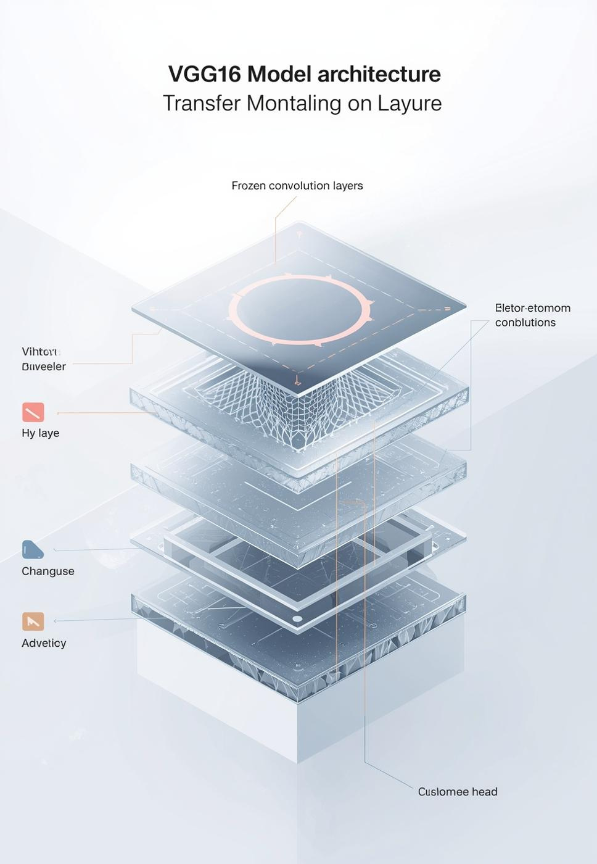
AI-POWERED SKIN CONDITION DETECTION
MODEL ARCHITECTURE
VGG16 Transfer Learning
Model Framework
The VGG16 architecture leverages transfer learning by utilizing a pretrained model with frozen layers for feature extraction. A custom dense head is added to classify images into three categories: acne, dark circles, and skin tone, enhancing accuracy and efficiency in skin condition detection.

Slide 6
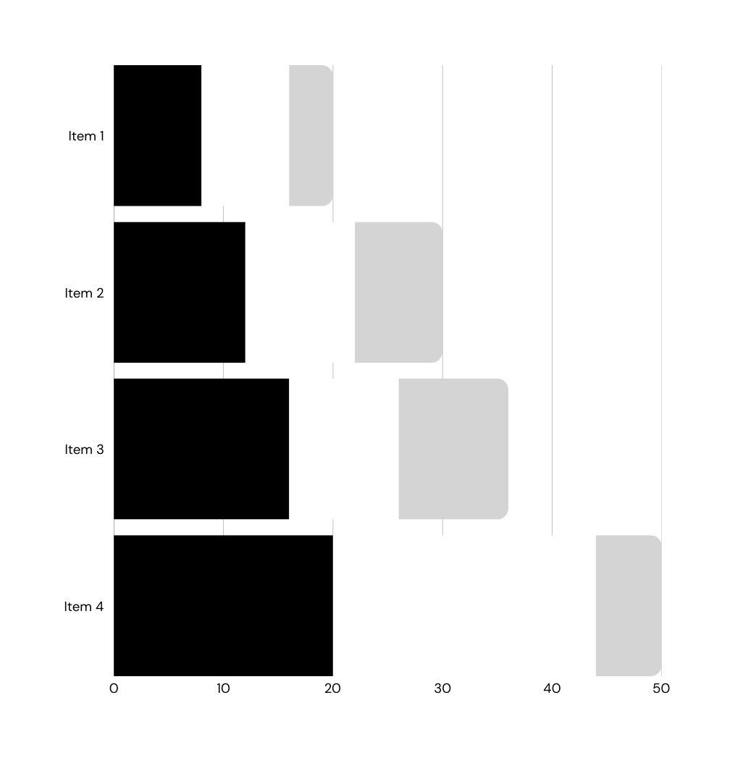
Training Performance Metrics
89
Validation accuracy achieved

Slide 7
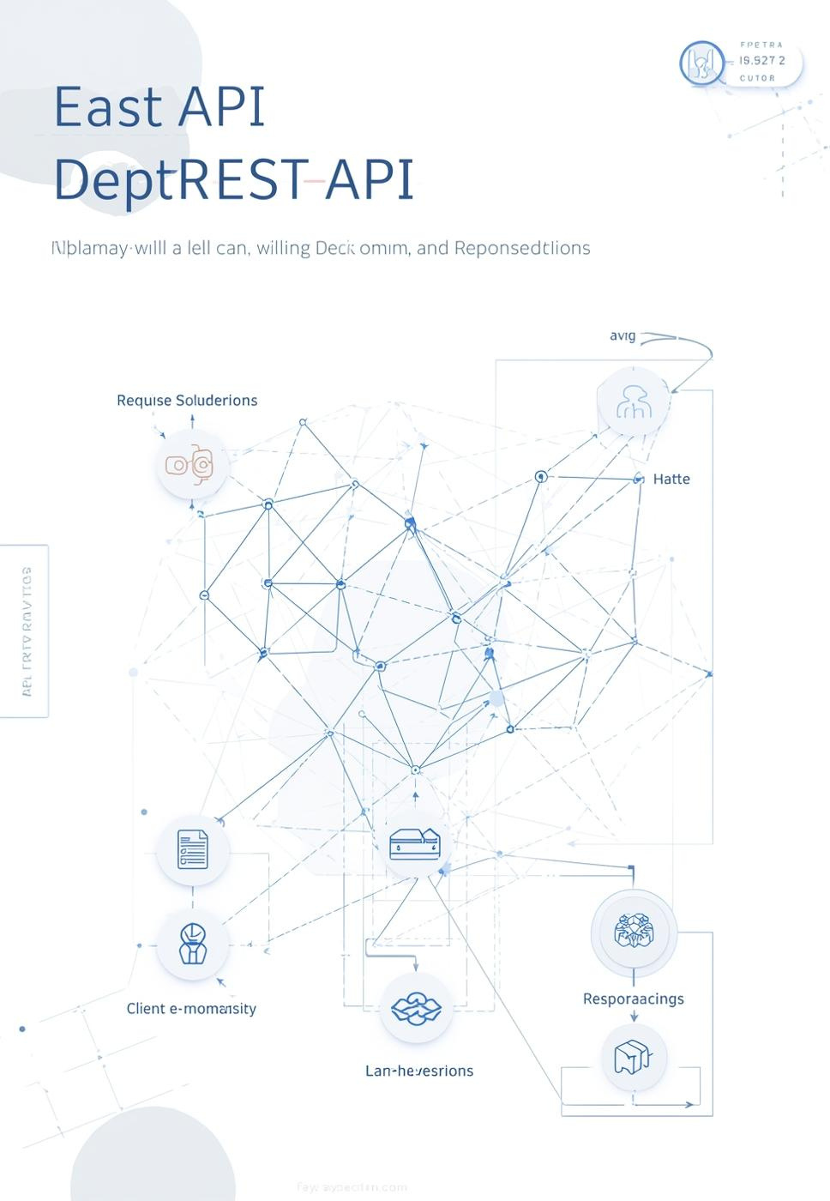
SKIN CONDITION DETECTION
API DEPLOYMENT
Deployment Workflow
How the Model Serves
The model is served through a Flask REST API, providing a simplified interface for users. The /predict endpoint returns a JSON response with the prediction and confidence level, allowing for seamless integration into applications and enhancing user experience through efficient real-time analysis.

Slide 8

LIMITATIONS
Current Model Constraints
The AI model faces challenges such as lighting sensitivity, potential bias in skin tone dataset, and limited analysis to single-frame images only.

Slide 9

SKIN CONDITION DETECTION
FUTURE ENHANCEMENTS
Improvement Roadmap
Planned Innovations
Future enhancements to the AI skin analysis module include GAN-based simulations for improved training data generation, real-time edge inference for instant feedback, and advanced segmentation techniques like U-Net and Mask R-CNN to increase detection accuracy across varying skin types and conditions.

Slide 10
Thank you!

